Slide 1
Developing and Maintaining Customer Relationships through Social Media.
Peter “webdoc” Martin

Slide 2
1 out of every 5 minutes
spent online is on social.
Social continues to grow
and you need a
Social Marketing Plan
to see big growth in
2015 and beyond.
Ask Your Customers If They Are Happy

Slide 3
The Impact that Social Media has on your Google placement
Less than 1% go past Page One on Google
90% of all shopping starts online and if you are not on page one you are INVISIBLE

Slide 4
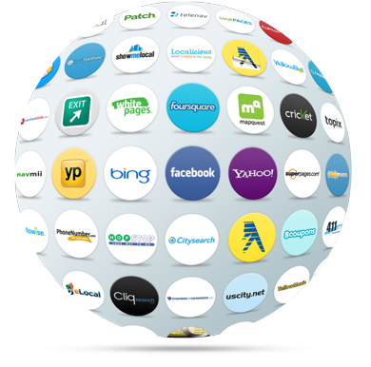
Crossover between Social and Review Sites
There are over 50 major review sites that have social integration :
Yelp
Google+
CitySearch
Yellow Pages
Yahoo Local

Slide 5
Social Media can sell a lifestyle
Social Media is a venue for consumers to share. Increase sales as people share the enjoyment of the RV lifestyle.
Source: Bright Local 2014

Slide 6
Social Media Stats
Over 90% of shoppers start their research online.
Social media is the new word of mouth advertising
92% of consumers around the world trust word of mouth advertising the most
40% of business owners feel that social media amplifies word of mouth referrals
Brands use social media accounts to build relationships with fans
52% of marketers have gained a customer through Facebook
35% have gained a customer through Twitter
Only 20% of Chief Marketing Officers are engaging with customers on social, time to
step it up

Slide 7
The Top Social Site
Facebook is the number one social site.

Slide 8
The Top Social Site
Do You have a Facebook Fan Page?
How many Likes do you have?

Slide 9
The average woman checks her Facebook account 10 times a day.

Slide 10
In all your emails, provide a way to get feedback Privately
Facebook gives you the opportunity to tell your story to prospects with contributions from current customers about their experiences.
Source: Bright Local 2014

Slide 11
Twitter is a conversation network. Answer customer inquiries FAST.

Slide 12
YouTube is the 2nd largest search engine
From a total marketing perspective YouTube is one of the most important and beneficial tools that is available today.
Owned by Google.

Slide 13
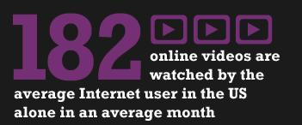
Incorporate videos into your posts to increase exposure.

Slide 14
LinkedIn is a great way to connect with local business owners.
Purchase a database of all the business owners in your area and then add them to your LinkedIn account.

Slide 15
Why is Yelp Important?
Yelp has emerged as a major player in the online review space and has the ability to post directly to Facebook and other social media favorites.

Slide 16
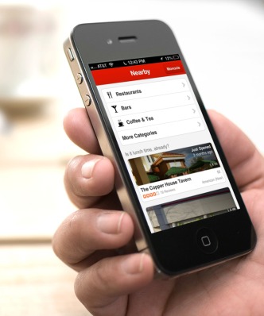
Yelp Is Connected to Siri
Half of all Smart Phone Owners have a iPhone.

Slide 17
The POWER of Pictures
A picture says a thousand words and image-based social media is growing.

Slide 18
Pinterest
Most popular social network for women
Recently rolled out “Pinterest for Business” feature

Slide 19
Instagram
Instagram is popular with a younger demographic
Owned by Facebook
Your goal is to promote a lifestyle and family time is a key component.

Slide 20
Developing a
Plan and
Best Practices
Dealership

Slide 21
Claiming Your Social Sites
It is imperative you claim ALL social sites with consistent credentials (Name, Address, Phone)

Slide 22
Are Your Posting on Multiple Social Sites?
You need to be active on more than one channel

Slide 23
Don’t SPAM…
Do social the correct way, don’t connect accounts
and post the same message.
Tailor your message for each account.
Instagram and Pinterest are for images
YouTube is for video
Twitter limits you to 140 characters
Facebook is for longer posts
Ask Your Customers If They Are Happy

Slide 24
SEO Algorithm Incorporated Into Review Sites
Develop different audiences and send the same message for each audience.

Slide 25
In all your emails, provide a way to get feedback Privately
Follow the 80/20 rule
80% of your posts are social
20% are about inventory
Talk about all of the great things that you do
in the community. Build your brand reputation
and the customers will follow.
Source: Bright Local 2014

Slide 26
In all your emails, provide a way to get feedback Privately
Don’t just link to vehicles.
Just like email does not sell motorhomes, social does not either. If all you do is post inventory you will lose the fans and followers you have worked so hard to gain.
Engage don’t pitch!
Source: Bright Local 2014

Slide 27
Develop a brand personality….
Social should be fun

Slide 28
Monitor, Listen and Respond
Fans post on brand’s social media to get a response
86% of Facebook user and 71% of Twitter users expect a response within the same day
42% expect response within 60 Minutes
32% expect a response within 30 Minutes
Ask Your Customers If They Are Happy

Slide 29
Consumers are looking
Buyers get started on dealer's website or Facebook page
Look for the capability of booking appointments online
Finding deals and latest specials through Facebook and Twitter
Want to get a head start on negotiating through interaction

Slide 30
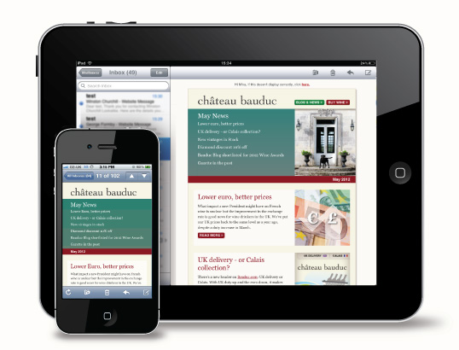
Mobile is a key component of
Social Media Marketing.
Source: Returnpath

Slide 31
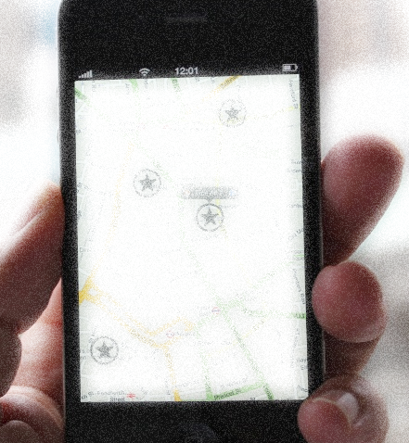
The Mobile Shopper:
51% of shoppers use their mobile device to look up price, payments and offers
29% researched inventory on mobile device
17%
51%
29%

Slide 32
Build your audience with your current leads
Use the leads in your CRM to build your audience.

Slide 33
Use email marketing to invite them to follow you.
Contests are a great tool as well.

Slide 34
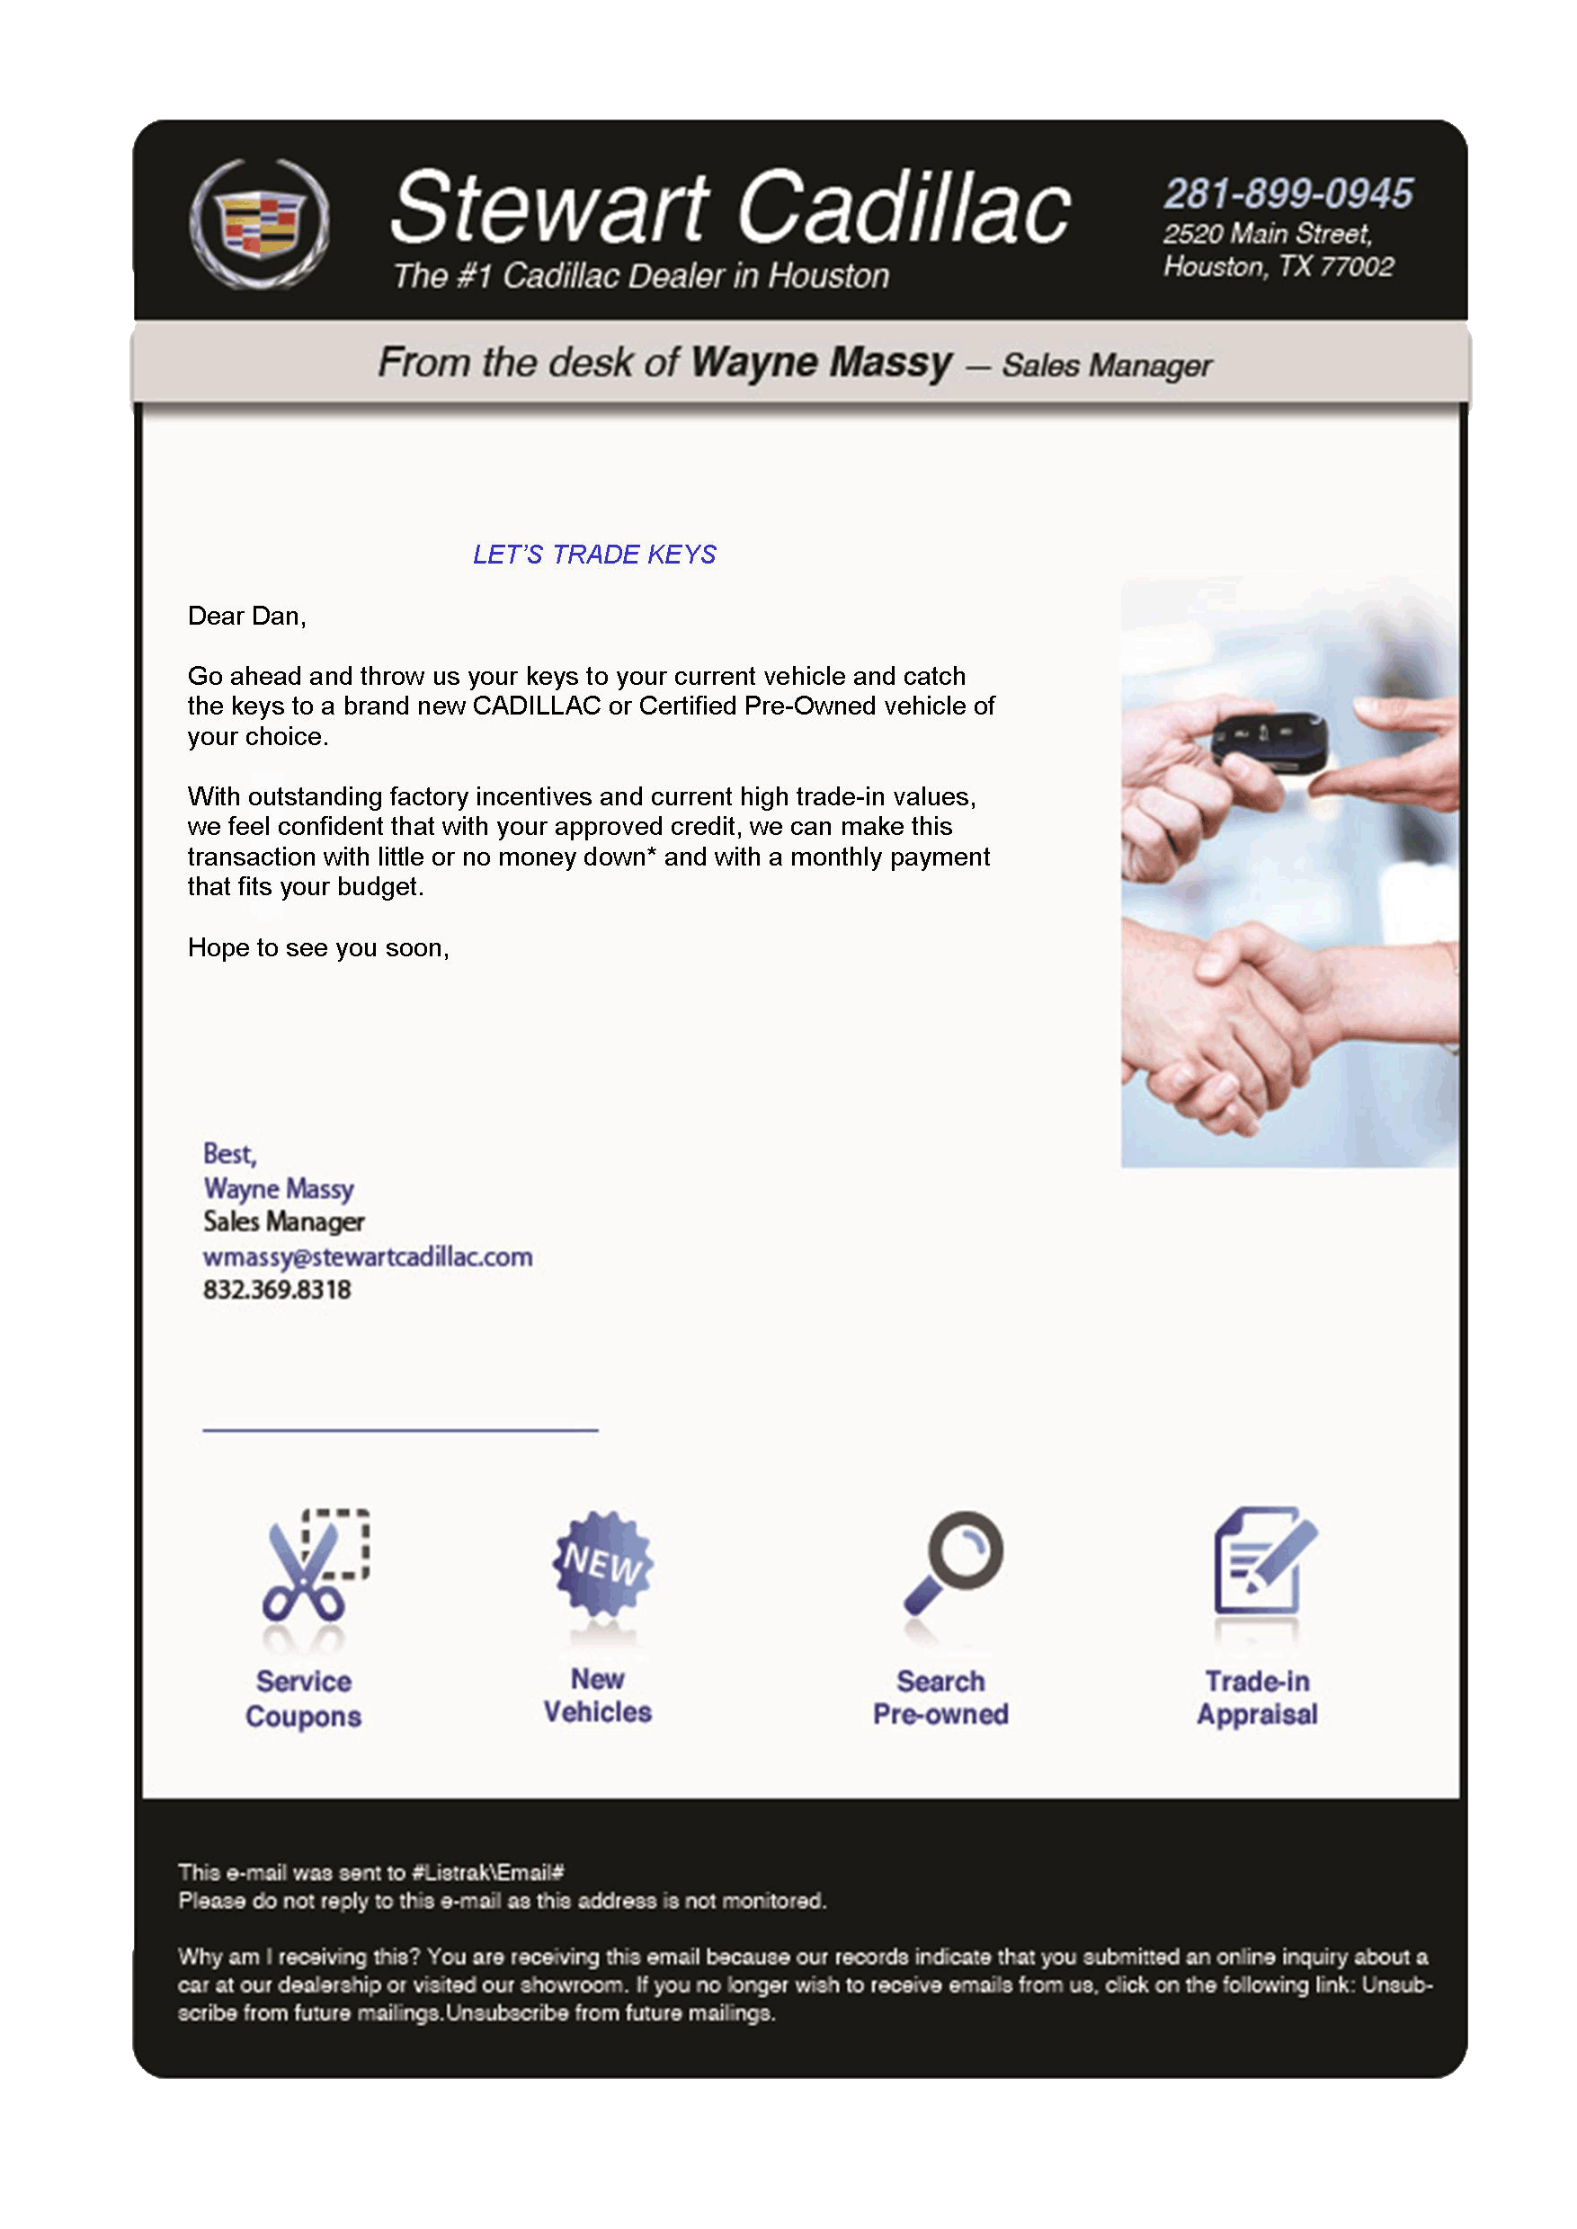
Use professional
HTML emails and
track the results.

Slide 35
By developing a social media plan and budget you will be
able to reach more prospects and drive more sales.

Slide 36
Monitor, Listen and Respond
Source: Bright Local 2014

Slide 37
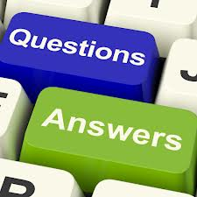

Slide 38
Peter “the Webdoc” Martin
941.756.1932 office
954.205.7716 cell
peter@cactusskydigital.com

