Slide 1
Yelp Reviews and Your Online Reputation.
Peter “webdoc” Martin

Slide 2
How Your Online Reputation
Influences Sales
86% of RV shoppers are searching online first
Source: Internet Retailer

Slide 3
Moment of Truth
72 % of consumers say that positive reviews make them trust a local business more
Source: Bright Local 2014

Slide 4
Why is Yelp Important?

Slide 5
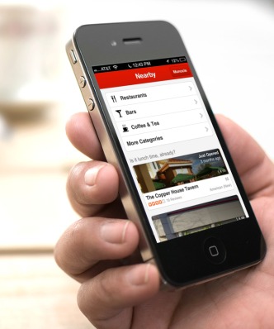
Yelp Is Connected to Siri
Half of all Smart Phone Owners have a iPhone.

Slide 6
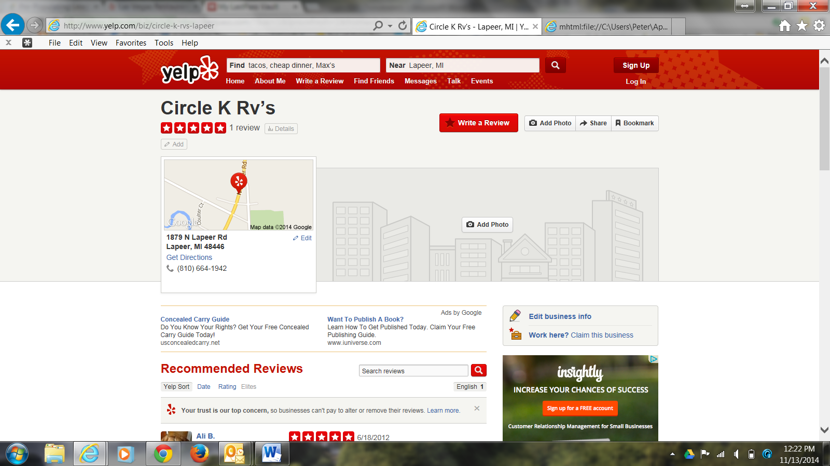
Not Claimed Yelp Page

Slide 7
Actual customer Yelp Review
Yelp Review by Angela D.
the service department seems to have taken a turn for the worse. I've been here for an hour and the oil change is still not done.

Slide 8
Help for Yelp
No pay - No Review
Get customers continuously submitting reviews. This lowers your risk of having a yelp account left with only negative, or no reviews at all.

Slide 9
The Challenge
Yelp is quick to publish negative reviews and slow to put up recommended reviews.

Slide 10
Yelp is all about authentic reviews
Yelp strives to ensure that reviews are authentic. One major factor they look at is the activity of the Yelper.
They also monitor location of check-ins using GPS.

Slide 11
The Yelp Program

Slide 12
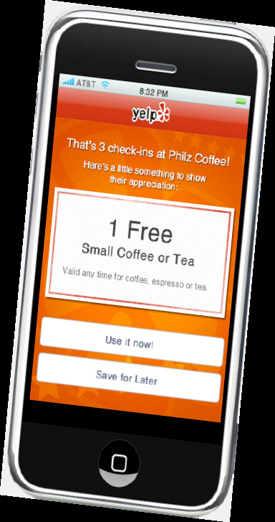
Video Message from Dealership
Create a check-in offer on Yelp

Slide 13
The Program.
We have found that when you have someone check-in at your dealership and then a few days later submit a review they are published.
Logically, if the customer checks in from your dealership and Yelp tracks it via GPS and a few days later a review is submitted then Yelp knows that it is authentic and publishes it.

Slide 14
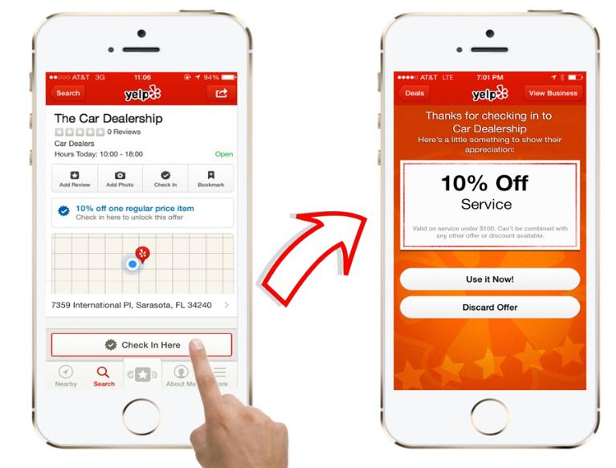
Yelp Program
Customers check in on Yelp and receive a coupon

Slide 15
Business cards are inexpensive to hand out.

Slide 16
Yelp Program
When customers are waiting, this is the perfect time for them to check in on Yelp. Your staff can hand them our cards, specially made with scan-able QR codes that go directly to your Yelp page

Slide 17
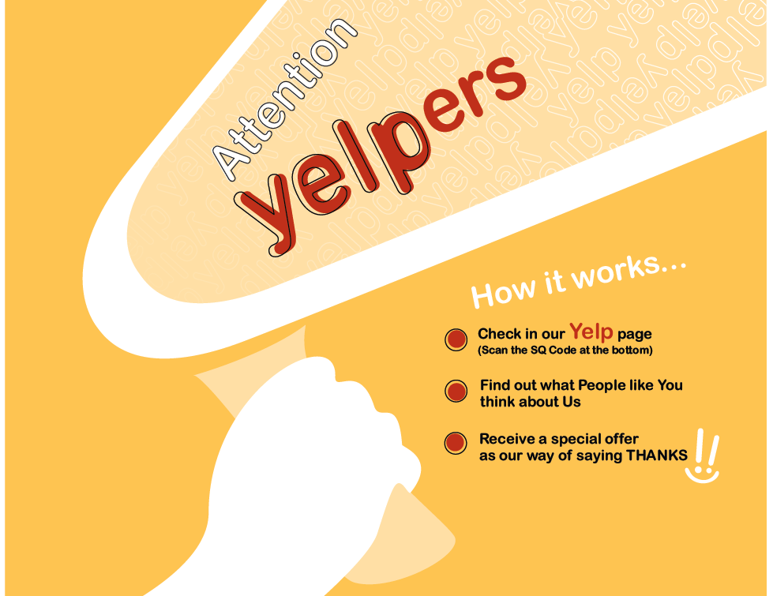
Point of purchase materials

Slide 18
Use a QR code to link to your page.

Slide 19
People Trust their Friends
Reliability (27%), Expertise (21%) and professionalism (18%) are the most important reputation traits for a focal business
9/10 Consumers will trust an online review as much as a personal recommendation
Source: Bright Local 2014

Slide 20
Top Review Sites
To be successful, you must be seen on these review sites:
Yelp
Google+
CitySearch
Yellow Pages
Yahoo Local

Slide 21
Claiming Your Sites
It is imperative you claim ALL review sites with consistent credentials (Name, Address, Phone)
22% of business information online is incorrect

Slide 22
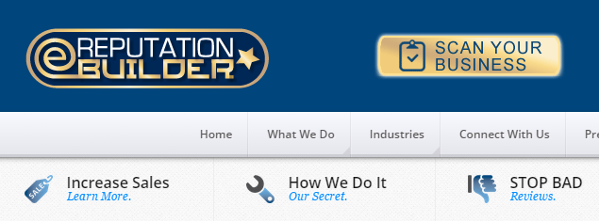
Consistent Name Address and Phone Number across the Top Review Sites
Check how your dealership looks on Review Sites, Maps and Apps:
www.erepbuilder.com/scan

Slide 24
The Importance Of Online Reputation
Less than 1% go past Page One on Google
Online reviews rank highest
Not visible to consumers
You WILL lose sales

Slide 25
SEO Algorithm Incorporated Into Review Sites
Google incorporates your online reputation into the ranking algorithm.

Slide 26
Where Do You Rank?
Dealers miss the pivotal opportunity to get a review on the review sites that Google says are credible.

Slide 27
Are Your Reviews Visible on Multiple Review Sites?
Beware of reputation management companies that only place positive reviews on YOUR website.

Slide 28
How many stars do you have?
92%
What average star rating is too low for you to consider using a local business?
72%
27%
13%
Source: Bright Local 2014

Slide 29
High Stakes Game
72% of Buyers influenced by Online Dealership Reviews

Slide 30
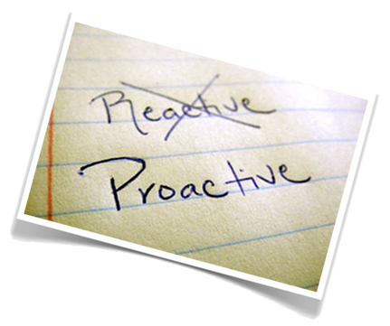
Proactive Competitive Advantage
Credible service reviews
Automated “Organic Slow Drip”
The Google Black Hole
Be proactive not reactive

Slide 31
Follow up Program
follow up with an email asking them to leave a review if they are satisfied or fill out a contact form if they weren’t. This gives you the opportunity to stop a bad review before it’s posted

Slide 32
Email Challenge
50% to 70% of your customer and prospect database is comprised of:

Slide 33
Step Up to the Plate
Ask Your Customers If They Are Happy
Use interactive HTML email to contact your customers and ask them for a review.
Link them to 3rd party review sites.
Give them an opportunity to complain to you 1st

Slide 34
Mobile Responsive
66% of consumers are reading marketing messages on a mobile device. This number rises to 67% for Millennials.

Slide 35
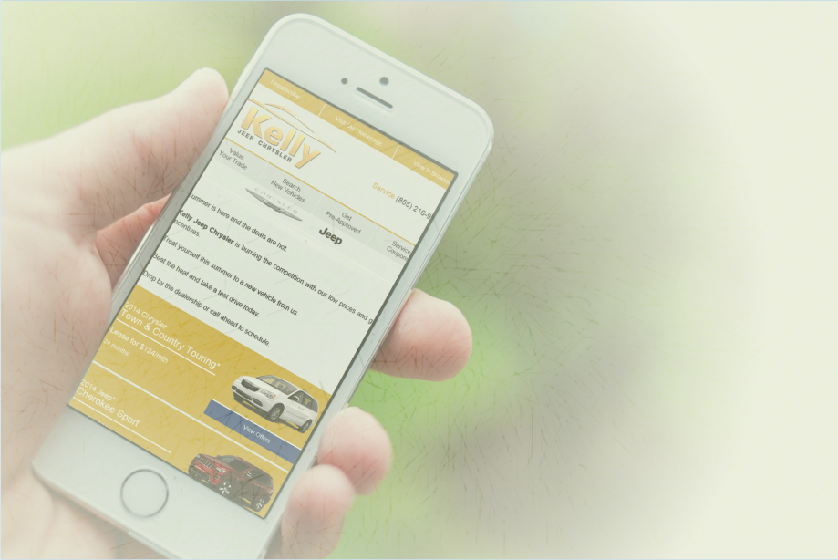
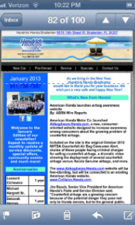
Importance of Mobile-Enabled Emails
This is an example of an email that is NOT mobile-responsive.

Slide 36
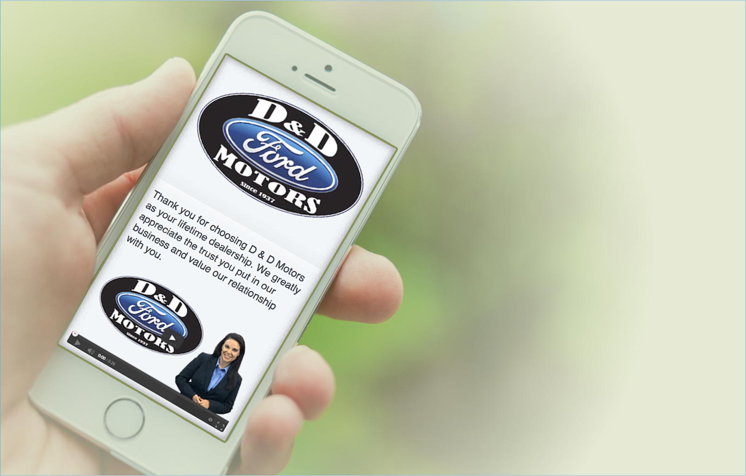
Mobile-Enabled
78% of consumers delete an email that does not adapt to their mobile device

Slide 37
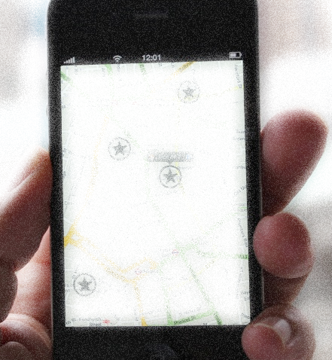
The Mobile Shopper:
Reviews Matter
51% of shoppers use their mobile device to look up price, payments and offers
29% researched inventory on mobile device
17% wanted to see reviews on mobile device
17%
51%
29%

Slide 38
Address the Negative…
Ask Your Customers If They Are Happy
A negative review will pop up in 35% of the searches for your dealership

Slide 39
Both Service and Sales customers should be contacted
Interactive HTML
Mobile-enabled email
Offer links to 3rd party review sites
Ask for the review
See if they’re happy

Slide 40
Video Message from Dealership

Slide 41
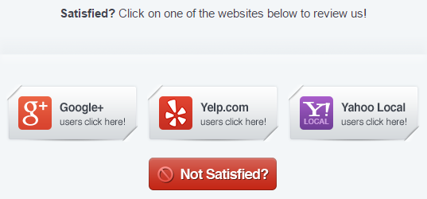
In all your emails, provide a way to get feedback Privately
The Power of the Not Satisfied Button
Source: Bright Local 2014

Slide 42
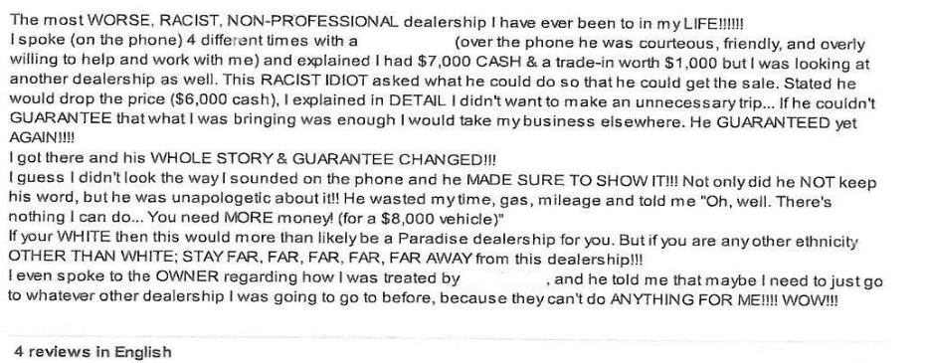
Address the Negative…
Ask Your Customers If They Are Happy

Slide 43
ACTUAL Not Satisfied complaint that was submitted about one of our clients
Which was NOT published online:
Ask Your Customers If They Are Happy
“Ur the biggest @#*!% scumbag on the face of the planet I hope u die and everyone that works for u also. Please use a hand grenade in the middle of ur dealership and make sure everyone that u kno and works for u is standing there”

Slide 44
Fix the Problem
Ask Your Customers If They Are Happy
Dealership
Only 4% of unhappy consumers will complain to you
90% of customers will come back to your dealership if you address their concern

Slide 45
Monitor, Listen and Act
Ask Your Customers If They Are Happy
Proactively monitor your online reputation, communicating and listening to your customers and acting immediately when a negative review or complaint is initiated.
Build Your …
Reputation, Sales & SEO

Slide 47
Peter “the Webdoc” Martin
410.296.2343 office
941.756.1932 office
954.205.7716 cell
peter@cactusskydigital.com
www.dealerinfluence.com
www.thewebdoc.tv
www.automotivedigitaltraining.com
www.cactusskydigital.com

